Slide 1
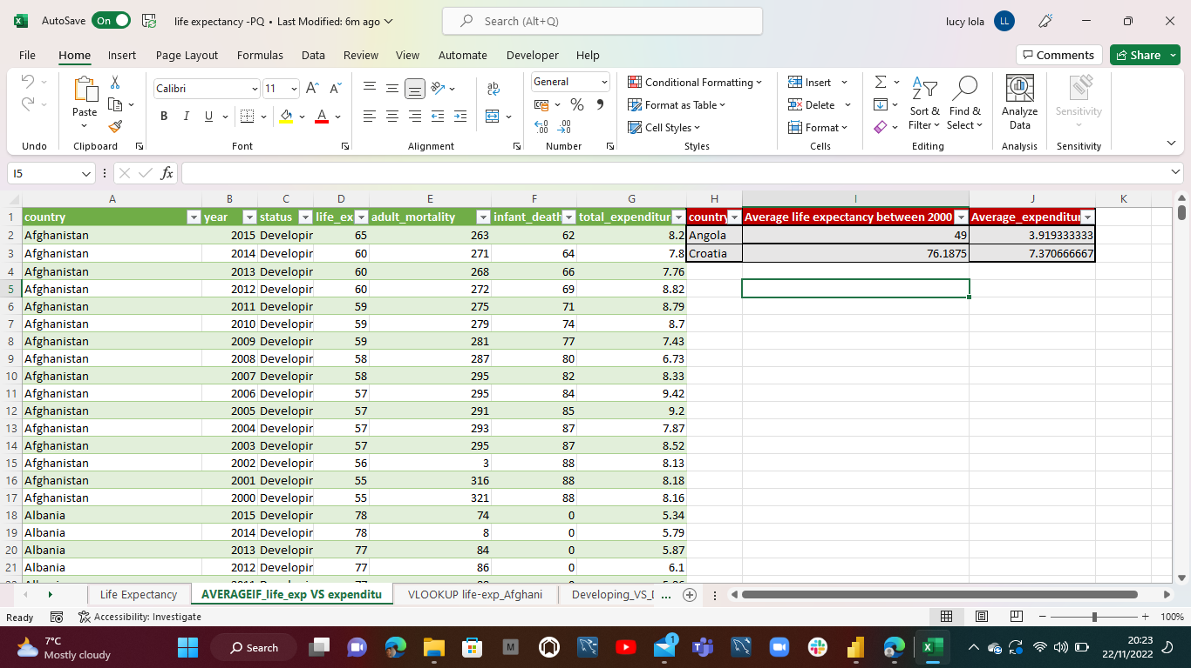
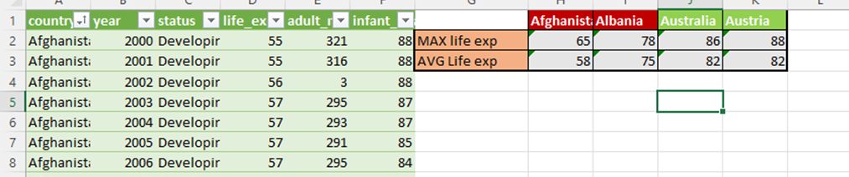
Excel Analysis
Using AVERAGEIF function to find average life expectancy and average total expenditure for Various countries
Using MAX function and AVERAGE function to find the Maximum life expectancy and Average Life expectancy in countries with Different status (Developed and Developing

Slide 2
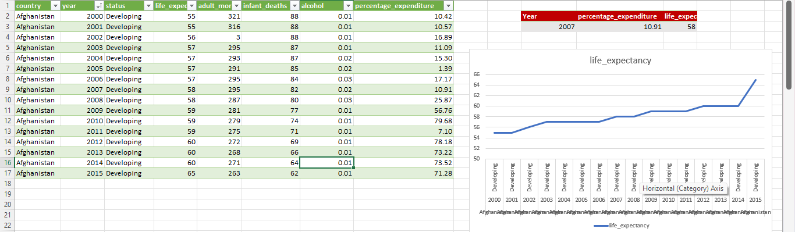
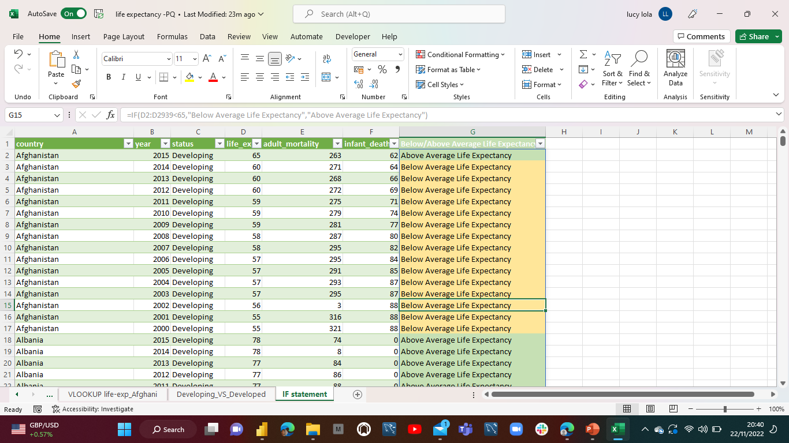
Excel Analysis
Using VLOOKUP to return the Life expectancy VS expenditure for Afghanistan over the years. Performed a quick analysis to show trend
Using IF statement to make logical comparison between above average life expectancy (>65) and below average life expectancy(<65)

Slide 3
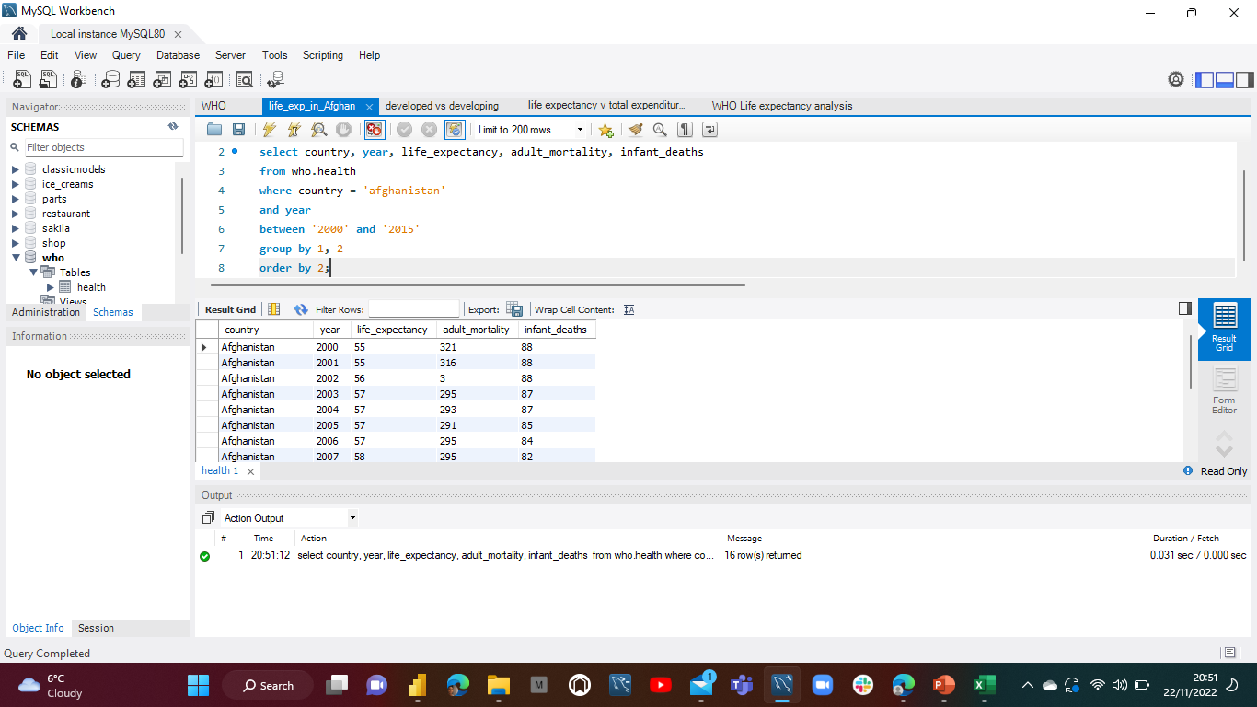
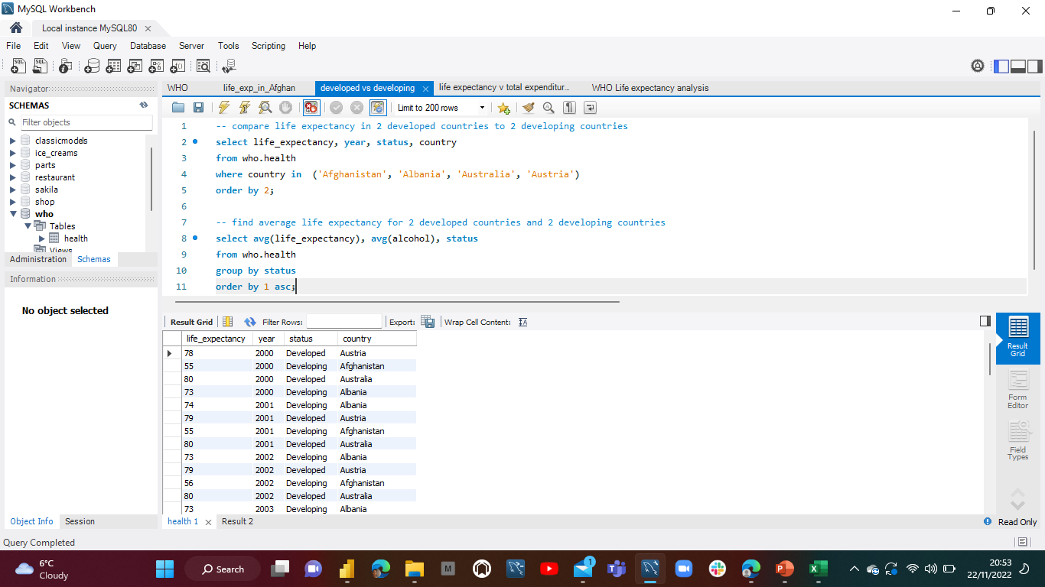
Excel Analysis
Life expectancy in Afghanistan between 2000 and 2015
Difference in Life expectancy between developed and developing countries

Slide 4
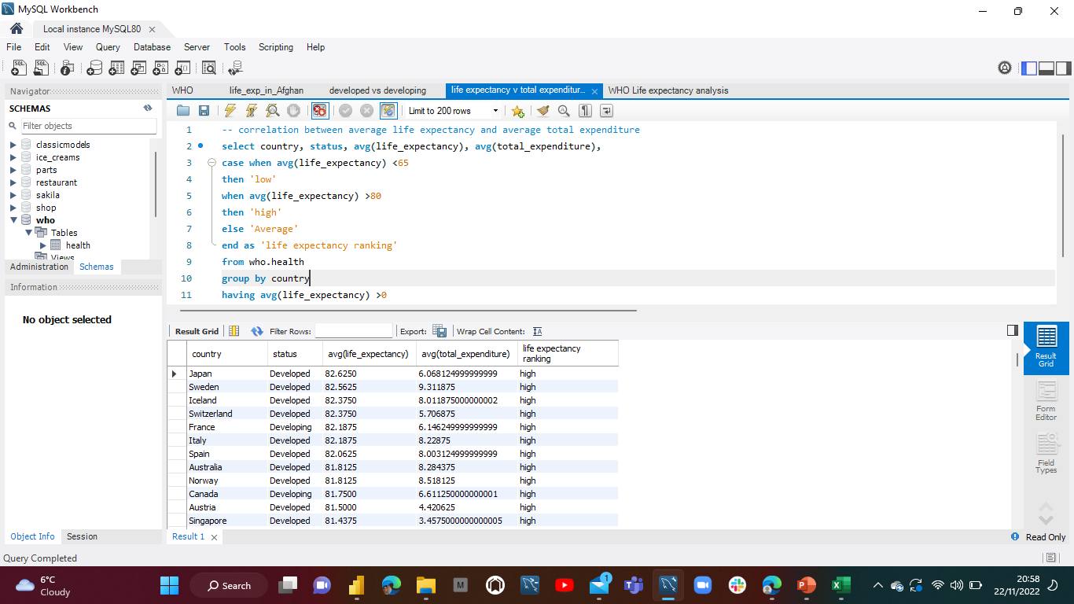
Excel Analysis
Correlation between average life expectancy and average total expenditure across various countries

Slide 5
Factors Aﬀecting Life Expectancy Afghanistan 2000-2015
Identifying potential factors that may impact Life Expectancy within a particular country. Here, we have chosen to analyse Afghanistan, a developing country, and the impact of Infant deaths and Adult mortality on life Expectancy.
66
64
62
60
58
56
54
90
80
70
Afghanistan _{Country}
Afghanistan Albania Algeria Angola
Antigua and Barbuda Argentina
Armenia Australia Austria Azerbaijan Bahamas Bahrain Bangladesh Barbados Belarus Belgium Belize Benin Bhutan
Bolivia (Plurinational .. Bosnia and Herzegovi.. Botswana
Brazil
Brunei Darussalam Bulgaria
Life Expectancy
Infant Deaths
60
Afghanistan
Burkina Faso Burundi CÃ´te d'Ivoire Cabo Verde Cambodia Cameroon Canada
Central African Repub.. Chad
Chile China Colombia Comoros Congo
Cook Islands
300
Adult Mortality
Afghanistan
200
100
2000 2001 2002 2003 2004 2005 2006 2007 2008 2009 2010 2011 2012 2013 2014 2015
Year
Country
Afghanistan

Slide 6
Correlation Between Status and Life Expectancy
Looking at the Correlation between Status and Life Expectancy, 3 developing countries ( Afghanistan, Algeria and Albania) and 3 developed countries (Australia, Belgium and Germany) were selected at random. The trend shows the developed countries have sign..
90
Country
Afghanistan Albania
Australia
Algeria Angola
Antigua and Barbuda Argentina
Armenia Australia Austria Azerbaijan Bahamas Bahrain Bangladesh Barbados Belarus Belgium Belize Benin Bhutan
Bolivia (Plurinational .. Bosnia and Herzegovi.. Botswana
Brazil
Brunei Darussalam Bulgaria
Burkina Faso Burundi CÃ´te d'Ivoire Cabo Verde Cambodia Cameroon Canada
Central African Repub.. Chad
Chile China Colombia Comoros Congo
80
Germany
Algeria
70
Afghanistan
60
Life Expectancy
50
40
30
20
10
0
Status
2000 2001 2002 2003 2004 2005 2006 2007 2008 2009 2010 2011 2012 2013 2014 2015 _{Developed}
Year Developing

Slide 7
Average Life Expectancy VS Average Total Expenditure
The aim here is to determine whether the average government expenditure on health as a percentage of total government expenditure has an impact on average life expectancy, therefore exploring the possibil..
Country
Afghanistan Albania Algeria Angola
Antigua and Barbuda Argentina
Armenia Australia Austria Azerbaijan Bahamas Bahrain Bangladesh Barbados Belarus Belgium Belize Benin Bhutan
Bolivia (Plurinational .. Bosnia and Herzegovi.. Botswana
Brazil
Brunei Darussalam
Japan 82.63
Sweden 82.56
80
Portugal 80.00
Slovenia 79.75
75
Algeria 73.56
Average Life Expectancy
70
65
Cambodia
64.38
60
Country
Algeria
Angola Cambodia Japan Portugal Slovenia Sweden
55
Country
Algeria
Angola Cambodia Japan Portugal Slovenia Sweden
50
Angola
49.00
0
1
2
3
4
5 6
Average Total Expenditure
7
8
9
10

Slide 8


WHO Life expectancy Analysis
Factors Aﬀecting Life Expectancy: Afghanistan 2000-2015
Country
Afghanistan Albania Algeria Angola
Antigua and Barbuda Argentina
Armenia Australia Austria Azerbaijan Bahamas Bahrain
Adult Morta.. Infant Deaths Life Expecta..
65
60
55
Afgh
anistan
80
70
Afgh
anistan
300
200
100
Afghanistan
Country
Afghanistan
2000 2001 2002 2003 2004 2005 2006 2007 2008 2009 2010 2011 2012 2013 2014 2015
Year
Average Life Expectancy VS Average Total Correlation Between Status and Life Expectancy Expenditure
80
60 |  |  |  |  |  |  |  |  |  |  |  |  |  | Afg |  | hanistan
40
20
0
 | 2000 |  | 2002 |  | 2004 |  | 2006 |  | 2008 |  | 2010 |  | 2012 |  | 2014 2016
 |  |  |  |  |  |  |  |  | Year
Average Life Expectancy
80
Japan 82.63
Portugal 80.00
Swe 82.
den 56
Life Expectancy
70
Algeria
73.56
60
50
0
2
4 6
Average Total Expenditure
8
10
Country
Algeria
Angola Cambodia
Japan Portugal Slovenia
Country
Afghanistan Albania Algeria Angola
Status
Developed
Developing
Country
Afghanistan
Albania
Algeria

Slide 9
Learnings
Contributing Factors such as Adult mortality, Status and Government expenditure on health that have a negative impact on life Expectancy more prominent in developing countries.
There is a direct correlation between a country's status and life expectancy – life expectancy is significantly less in developing countries
A decrease in Infant deaths and Adult Mortality positively impact life expectancy
An increase in General government expenditure on health could impact life expectancy positively

